Slide 1


SRI RAMAKRISHNA ENGINEERING COLLEGE
[Educational Service : SNR Sons Charitable Trust]
[Autonomous Institution, Accredited by NAAC with ‘A’ Grade]
[Approved by AICTE and Permanently Affiliated to Anna University, Chennai]
[ISO 9001:2015 Certified and all eligible programmes Accredited by NBA]
VATTAMALAIPALAYAM, N.G.G.O. COLONY POST, COIMBATORE – 641 022.
16IT259 MINI PROJECT II
WEB APPLICATION FOR CROWD MANAGEMENT SYSTEM
PROJECT GUIDE TEAM MEMBERS
Dr.J.Anitha,
Asso.Professor, IT
Department of IT
Sabitha T (1805120)
Samayanjali M (1805121)
Yogapriya P (1805161)
III B.Tech IT-B

Slide 2
CONTENTS
Abstract
Introduction
Problem statement
Scope of the project
Literature review
Methodology
Flow diagram
Modules
Screenshots
References
Online course certificate
Conclusion

Slide 3
ABSTRACT
The steady increase in population and overcrowding has become an unavoidable factor in any public gathering or on the street during any festive occasions.
The intelligent monitoring technology has been developing in recent years and human tracking has made a lot of progress.
In this project, a method to manage the crowd by keeping in track the count of the people in the scene is proposed.
The interactive web application for the system that will provide the count of the human in the region using OpenCV Python.
HOG feature is trained for human detection. Human tracking is achieved by indicating the direction of movement of the person.
The results of the analysis will be helpful in managing the crowd in any area with high density of crowds.

Slide 4
INTRODUCTION
Modern technology provides solutions which make people’s life not only easier but also safer. Being in a highly crowded place affects not only the human level of comfort but mainly the human level of safety.
In this time when COVID-19 is spreading rapidly, it is essential to maintain social distance and avoid large public gatherings at one place to break the chain of the disease spread.
Many people, knowingly or unknowingly, gather and roam on the streets. Keeping an eye on all these activities is not an easy job. The authorities need reliable technology that can survey such places to prevent any unnecessary movement.

Slide 5
PROBLEM STATEMENT
A crowd is a gathering of people at some place. In this pandemic time, it is considered to be very dangerous being in a crowd as some deadly diseases like COVID-19 and flu can easily spread.
Also, large crowds result in accidents if preventive measures are taken with proper planning.
It is very much evident that large crowding is the part of the normal life and this exposes a new problem crowd management.Excessive crowding and poor crowd management results in loss of precious life very easily.

Slide 6
PROBLEM STATEMENT
It is not feasible to count or monitor all the people at various places like malls, shops, schools, colleges, railway stations, airports etc., at looking at them manually.
The complexity of monitoring, tracking and counting increases as the size of the crowd increases.
Hence the need for the development of an automated crowd management system will be highly appreciated by the society.

Slide 7
SCOPE OF THE PROJECT
The scope of the project is to develop the model into the user interactive web application so that it will be easier to use.
The system can be implemented in the public places where the real time visuals will be captured by the camera and alert the authorities accordingly.

Slide 8
LITERATURE SURVEY
No | Approach | Proposed By | Description
1 | Component based people detection | Anuj Mohan, Constantine Papageorgiou, and Tomaso Poggio | The technique is demonstrated by developing a system that locates people in cluttered scenes. In particular, the system detects the components of a person’s body in an image, i.e., the head, the left and right arms, and the legs, instead of the full body by using four distinct example based detectors
2 | DDMCMC approach | Tao Zhao and Bo Wu | A model based approach to interpret the image observations by multiple partially occluded human hypotheses in a Bayesian framework. This approach to segmenting and tracking multiple humans emphasizes the use of shape models.

Slide 9
LITERATURE SURVEY
No | Approach | Proposed By | Description
3 | Counting people without people models | Antoni B.Chan, Zhang-Sheng John Liang and Nuno Vasconcelos | A privacy-preserving system for estimating the size of inhomogeneous crowds, composed of pedestrians that travel in different directions, without using explicit object segmentation or tracking or models.
4 | Neural Network and EM based people counting and individual detection | Ya-Li Hou and Grantham K.H. Pang | Neural network based people counting and EM based individual detection in a low resolution image with complicated scenes

Slide 10
METHODOLOGY Histogram of Oriented Gradient (HOG)
HOG is a feature descriptor used in computer vision and image processing for the purpose of object detection. This is one of the most popular techniques for object detection.
HOG decomposes an image into small squared cells, computes an histogram of oriented gradients in each cell, normalizes the result using a block-wise pattern, and return a descriptor for each cell.
A feature descriptor is a representation of an image or an image patch that simplifies the image by extracting useful information and throwing away extraneous information.

Slide 11
METHODOLOGY Histogram of Oriented Gradient (HOG)
The first step in HOG detection is to divide the source image into blocks. Each block is divided by small regions, called cell.
For each pixel within the cell the vertical and horizontal gradients are obtained. A descriptor is assigned to each detector window.
This descriptor consists of all the cell histograms for each block in the detector window. The detector window descriptor is used as information for object recognition.
The architecture of the model is based on the Faster RCNN algorithm, which is an efficient and popular object detection algorithm which uses deep convolutional networks.

Slide 12
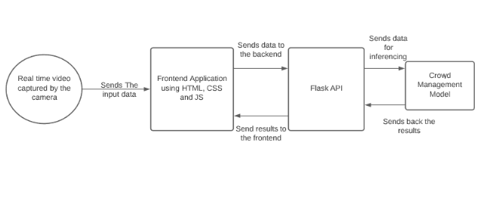
FLOW DIAGRAM

Slide 13
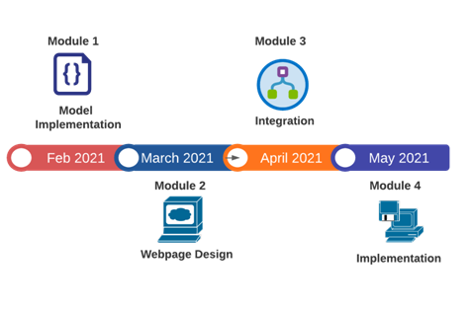
MODULES

Slide 14
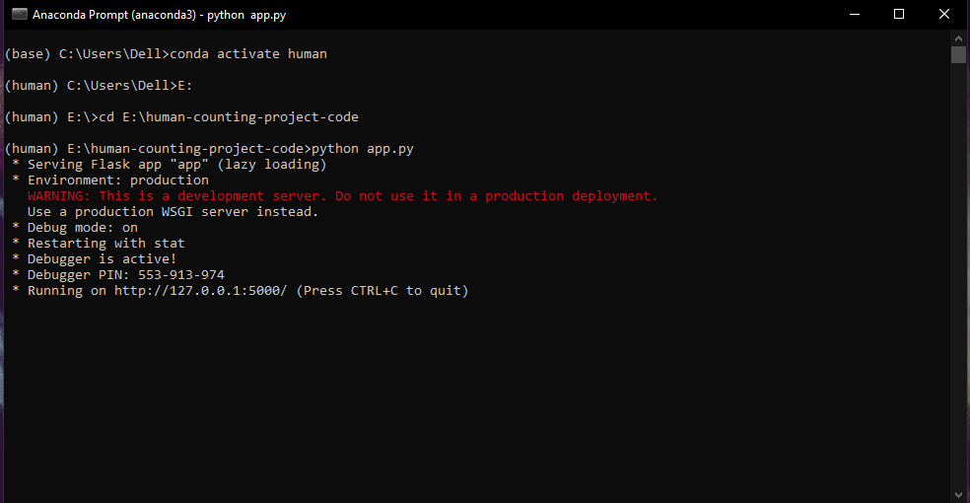
SCREENSHOTS

Slide 15
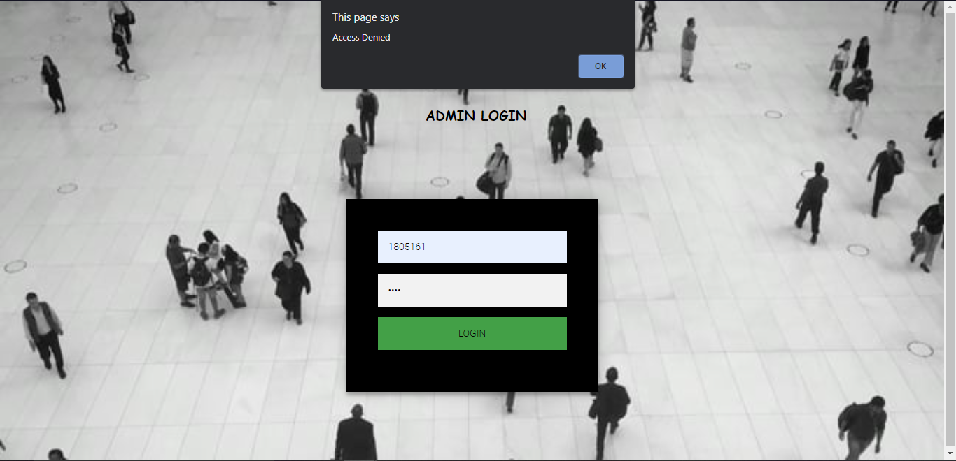
SCREENSHOTS

Slide 16

SCREENSHOTS

Slide 17
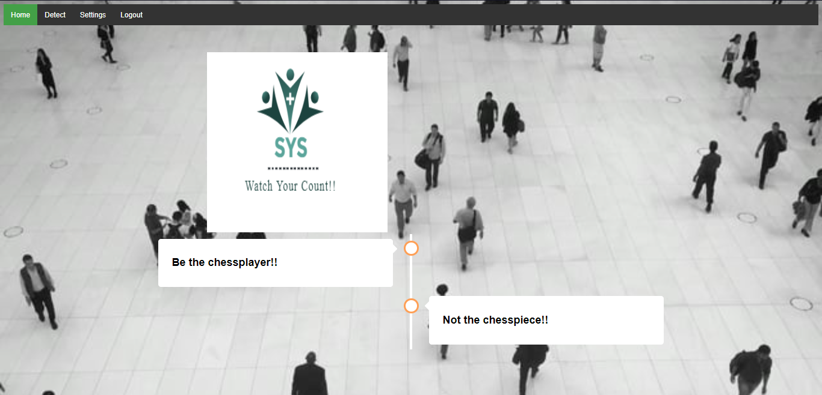
SCREENSHOTS

Slide 18
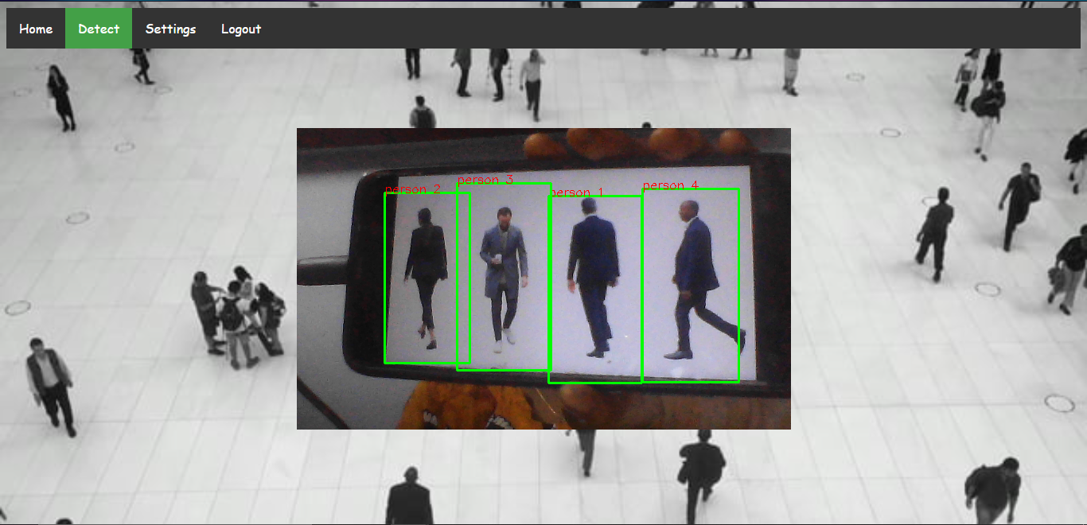
SCREENSHOTS

Slide 19
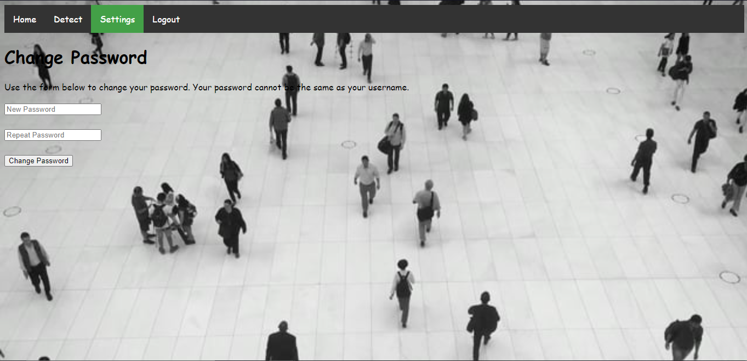
SCREENSHOTS

Slide 20
CONCLUSION
The scope of the project is to develop the model into the user interactive web application so that it will be easier to use.
The system can be implemented in the public places where the real time visuals will be captured by the camera and alert the authorities accordingly.
this program should be developed in parallel with statistical program for more convincible results

Slide 21
REFERENCES
T. Xu, X. Chen, G. Wei and W. Wang, "Crowd counting using accumulated HOG," 2016 12th International Conference on Natural Computation, Fuzzy Systems and Knowledge Discovery (ICNC-FSKD), Changsha, China, 2016, pp. 1877-1881, doi: 10.1109/FSKD.2016.7603465.
D. B. Sam, S. Surya and R. V. Babu, "Switching Convolutional Neural Network for Crowd Counting," 2017 IEEE Conference on Computer Vision and Pattern Recognition (CVPR), Honolulu, HI, USA, 2017, pp. 4031-4039, doi: 10.1109/CVPR.2017.429.
C. Shang, H. Ai and B. Bai, "End-to-end crowd counting via joint learning local and global count," 2016 IEEE International Conference on Image Processing (ICIP), Phoenix, AZ, USA, 2016, pp. 1215-1219, doi: 10.1109/ICIP.2016.7532551.
S. Huang et al., "Body Structure Aware Deep Crowd Counting," in IEEE Transactions on Image Processing, vol. 27, no. 3, pp. 1049-1059, March 2018, doi: 10.1109/TIP.2017.2740160.
Tianjun. Ma, Qingge. Ji, Ning. Li “Scene invariant crowd counting using multi-scales head detection in video surveillance” IET Digital Library Volume 12, Issue 12, December 2018, p. 2258 – 2263.

Slide 22
REFERENCES
6. Viresh Ranjan, Hieu Le, Minh Hoai “Iterative Crowd Counting” Proceedings of
the European Conference on Computer Vision (ECCV), 2018, pp. 270-285.
L. Zhang, M. Shi and Q. Chen, "Crowd Counting via Scale-Adaptive Convolutional Neural Network," 2018 IEEE Winter Conference on Applications of Computer Vision (WACV), Lake Tahoe, NV, USA, 2018, pp. 1113-1121, doi: 10.1109/WACV.2018.00127.
Lamba S., Nain N. (2017) , “Crowd Monitoring and Classification: A Survey”. In: Bhatia S., Mishra K., Tiwari S., Singh V. (eds) Advances in Computer and Computational Sciences. Advances in Intelligent Systems and Computing, vol 553. Springer, Singapore.
Miaojing Shi, Zhaohui Yang, Chao Xu, Qijun Chen, “Revisiting Perspective Information for Efficient Crowd Counting”, Proceedings of the IEEE/CVF Conference on Computer Vision and Pattern Recognition (CVPR), 2019, pp. 7279-7288.
Y. Tian, Y. Lei, J. Zhang and J. Z. Wang, "PaDNet: Pan-Density Crowd Counting," in IEEE Transactions on Image Processing, vol. 29, pp. 2714-2727, 2020, doi: 10.1109/TIP.2019.2952083.

Slide 23
THANK YOU

